Slide 1
Thermal Monitor
Kyele Haynes

Slide 2
Project Introduction
Office buildings and schools have many different bookable rooms that get used throughout the day.
Essential to the business for planning, workflow etc.
The Thermal Monitor uses the AMG8833 sensor to detect if and when people (heat signatures) are in the room and relay this information via the Raspberry Pi.
Help the facility make use of rooms more effectively and economically.

Slide 3
Project Budget
Part | Part Number | Supplier | Quantity | Cost | Comments
Raspberry Pi 3 B+ with power supply | C3775-5200 | Elmwood Electronics | 1 | $59.99 | Main control board
Adafruit AMG8833 IR Thermal Camera Breakout | 3538 | Elmwood Electronics | 1 | $59.99 | 8x8 array of IR thermal sensors, range of 7 meters
SUBTOTAL |  |  |  | $119.98
HST (13%) |  |  |  | $15.60
SHIPPING |  |  |  | $6.92
TOTAL |  |  |  | $142.50
Preowned
Parts Kit | N/A | Humber | 1 | $100 | Purchased at humber book store
Acrylic/case | N/A | Humber | 1 | $7 | To be done in prototype lab
Safety glasses | N/A | Already Own | 1 | $5
USB to Ethernet Adapter | N/A | Already Own | 1 | $16 | For connection to computer
Ethernet patch cable | N/A | Already Own | 1 | $8 | For connection to computer
TOTAL |  |  |  | $136
GRAND TOTAL |  |  |  | $278.50
Additional Notes:
Had to purchase an SD Card
Adds ~$12

Slide 4
Project Schedule
Task Name | Duration | Start | Finish
CribPi Raspberry Pi Blink Test | 1 hr | Tue 9/4/18 | Tue 9/4/18
Choose I2C device/Address | 1 hr | Tue 9/4/18 | Tue 9/4/18
Research on AMG8833 IR Thermal Camera | 26 days | Tue 9/4/18 | Tue 10/9/18
Research existing thermal camera projects | 11 days | Tue 9/11/18 | Tue 9/25/18
Proposal Rough Draft | 6 days | Tue 9/4/18 | Tue 9/11/18
Creating a schedule | 5 days | Wed 9/12/18 | Tue 9/18/18
Creating a list of needed parts/equipment | 6 days | Tue 9/18/18 | Tue 9/25/18
Creating a budget | 4 days | Thu 9/20/18 | Tue 9/25/18
Ordering/Delivery of parts | 16 days | Tue 9/25/18 | Tue 10/16/18
Setup Raspberry Pi OS | 11 days | Tue 10/2/18 | Tue 10/16/18
Pseudo code assignment, working with first years | 6 days | Tue 10/9/18 | Tue 10/16/18
Implementing project with breadboard | 11 days | Tue 10/9/18 | Tue 10/23/18
Designing PCB | 12 days | Fri 10/12/18 | Mon 10/29/18
Build Video/Script | 11 days | Tue 10/23/18 | Tue 11/6/18
Soldering PCB | 6 days | Tue 10/30/18 | Tue 11/6/18
Work on demonstration + progress report | 6 days | Tue 11/6/18 | Tue 11/13/18
Enclosure | 11 days | Tue 11/6/18 | Tue 11/20/18
Work on presentation | 11 days | Tue 11/13/18 | Tue 11/27/18
Presentation | 1 hr | Tue 11/27/18 | Tue 11/27/18
Build Instructions | 21 days | Tue 11/13/18 | Tue 12/11/18
Additional Notes:
Enclosure
Did not start until Nov 19
Finished Nov 26
Build Instructions
Have not started
Will not take as long as expected

Slide 5
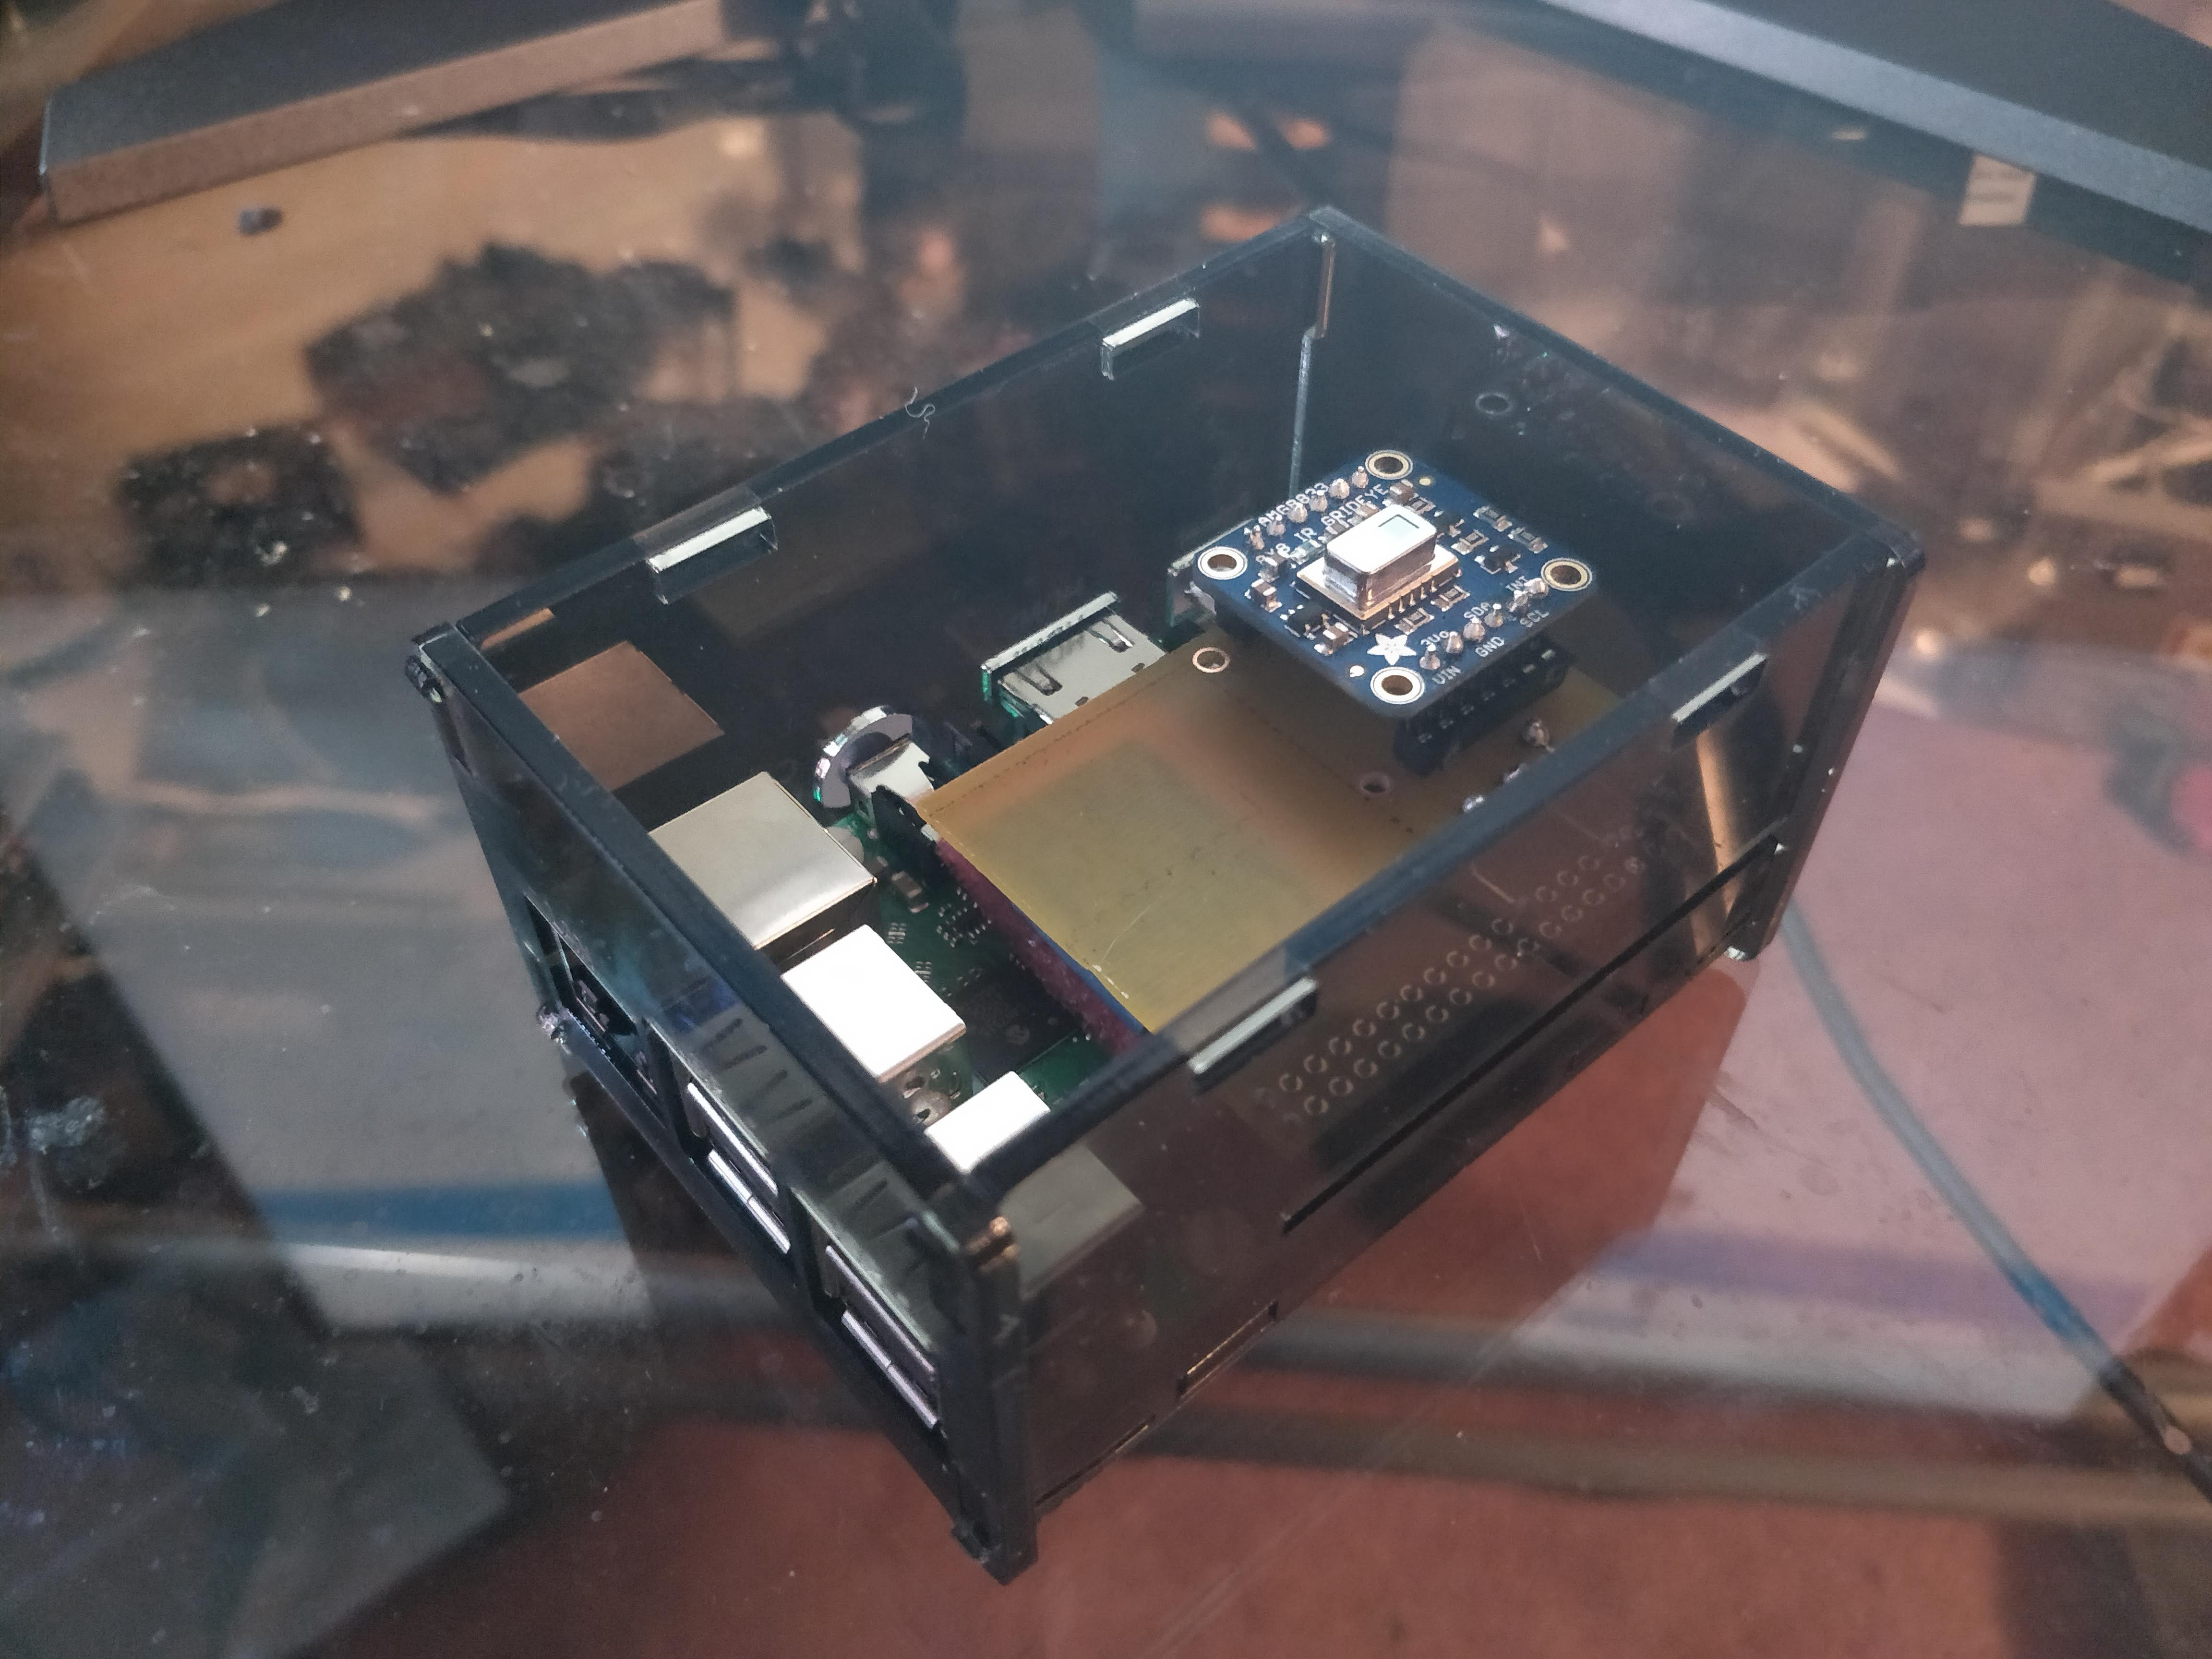
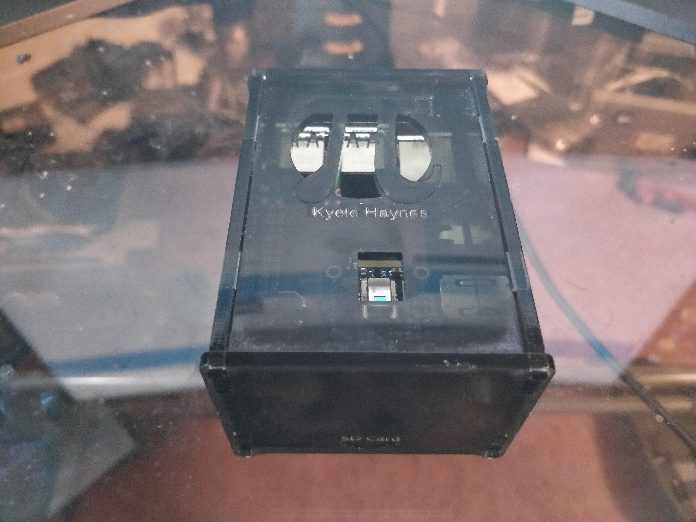
Enclosed Hardware

Slide 6
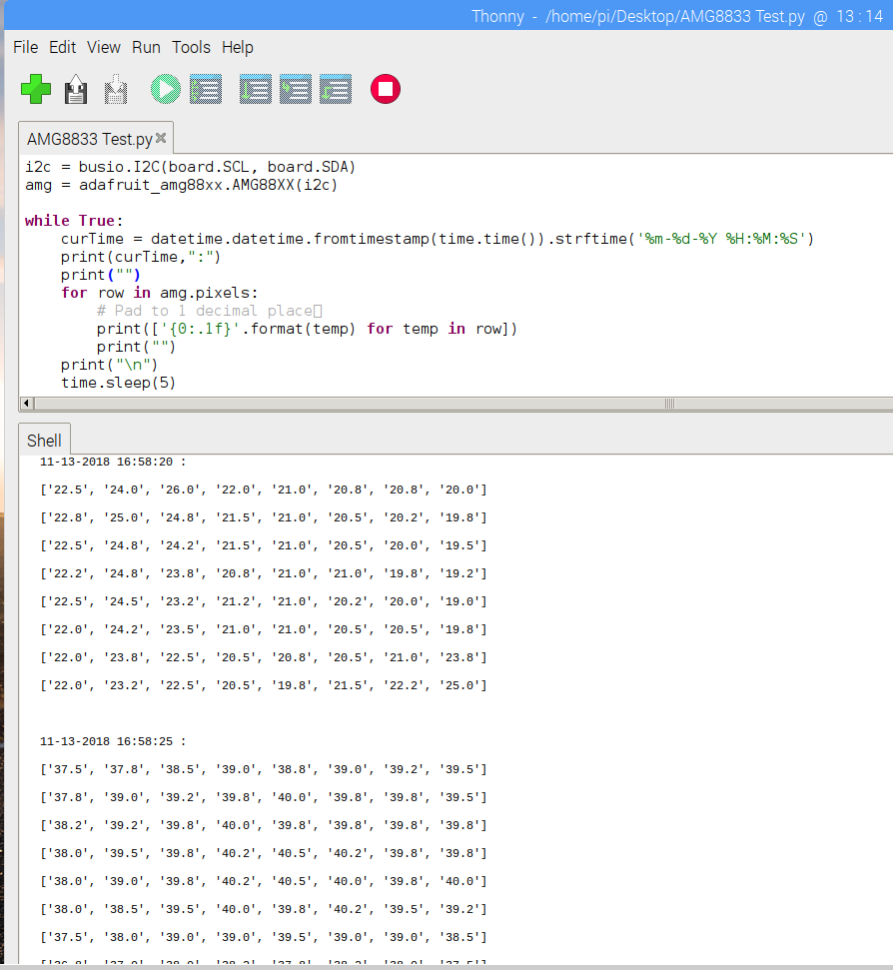
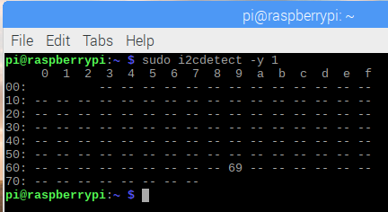
Reading From the AMG8833

